Slide 1
Advanced CNNs and Transfer Learning
Session 05
Dr. Hidayaturrahman, S.Kom., M.T.

Slide 2
Learning Outcome
LO1: Execute structured deep learning experimentation workflows, including data preparation, model training, and evaluation.
LO2: Construct deep learning models using modern programming tools and frameworks.
LO3: Analyze the behavior and performance of theoretical and practical deep learning models under various training scenarios.
LO4: Evaluate the suitability and limitations of different deep learning approaches for solving real-world problems across domains.

Slide 3
Outline
BatchNorm and Residual Connections
Transfer Learning & Fine-tuning
Data Augmentation Techniques
Pretrained Models (ResNet, EfficientNet)

Slide 4
Let’s start the session!

Slide 5
BATCH NORMALIZATION

Slide 6
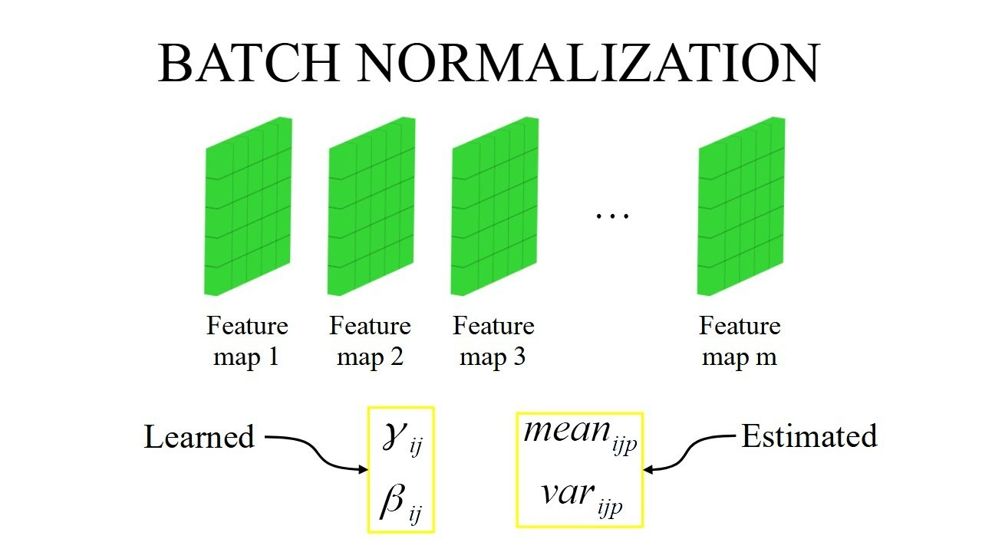
What is Batch Normalization?
Normalizes activations across mini-batch
Reduces internal covariate shift
Speeds up training and allows higher learning rates
Acts as regularizer

Slide 7
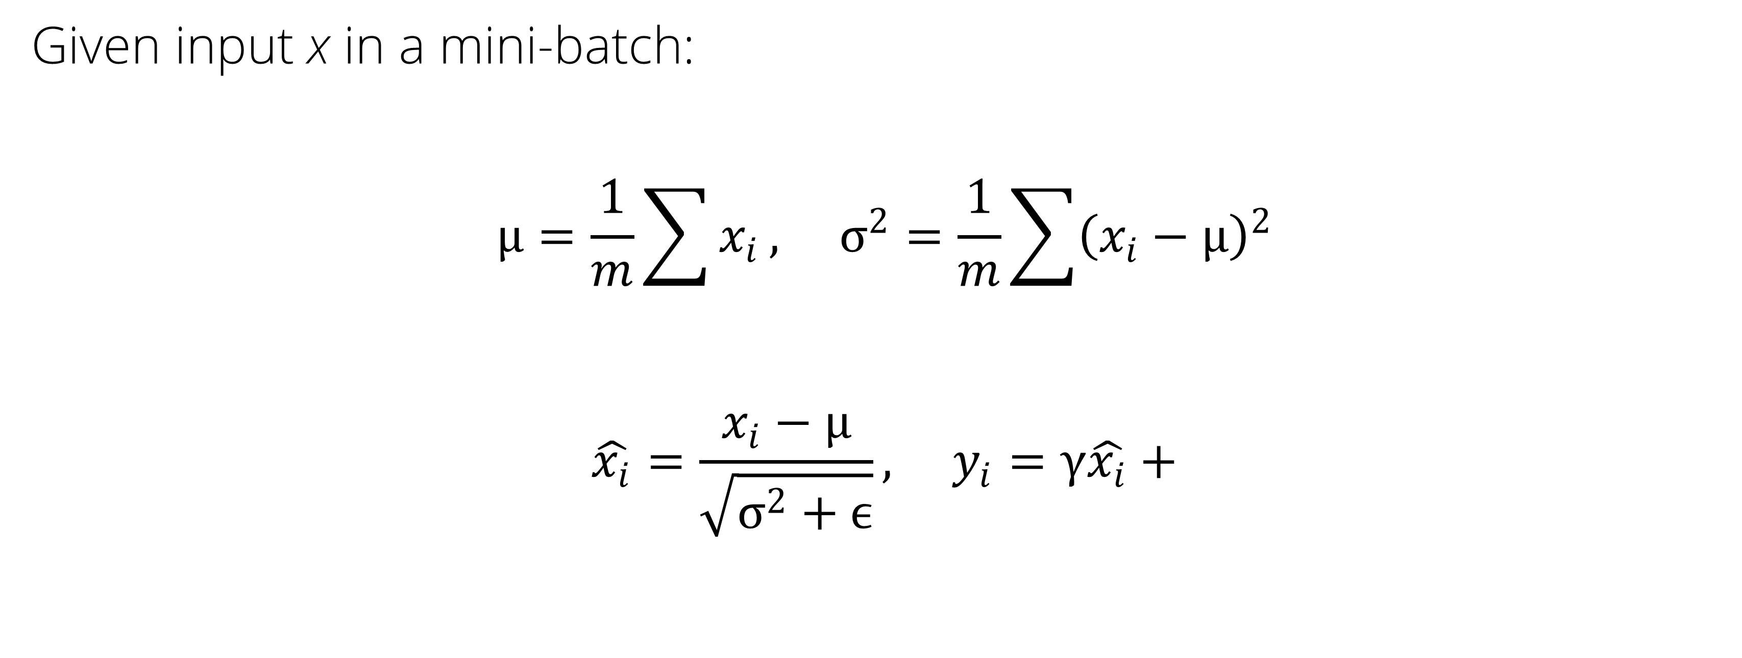
BatchNorm Equation
Given input x in a mini-batch:
$$μ=\frac{1}{m}\sum{x_{i}}, σ^{2}=\frac{1}{m}\sum{{\left(x_{i}−μ\right)}^{2}}$$
$$\hat{x_{i}}=\frac{x_{i}−μ}{\sqrt{σ^{2}+ϵ}}, y_{i}=γ\hat{x_{i}}+$$

Slide 8
Benefits of BatchNorm
Reduces dependence on initialization
Enables deeper networks
Acts like mild regularization
Often eliminates the need for Dropout

Slide 9
RESIDUAL CONNECTIONS

Slide 10
Deep Network Degradation
Deeper networks sometimes perform worse
Gradient vanishing or explosion
Information loss across layers

Slide 11
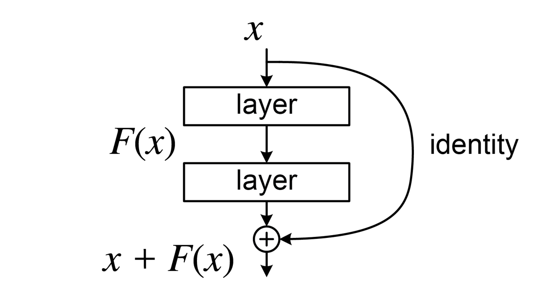
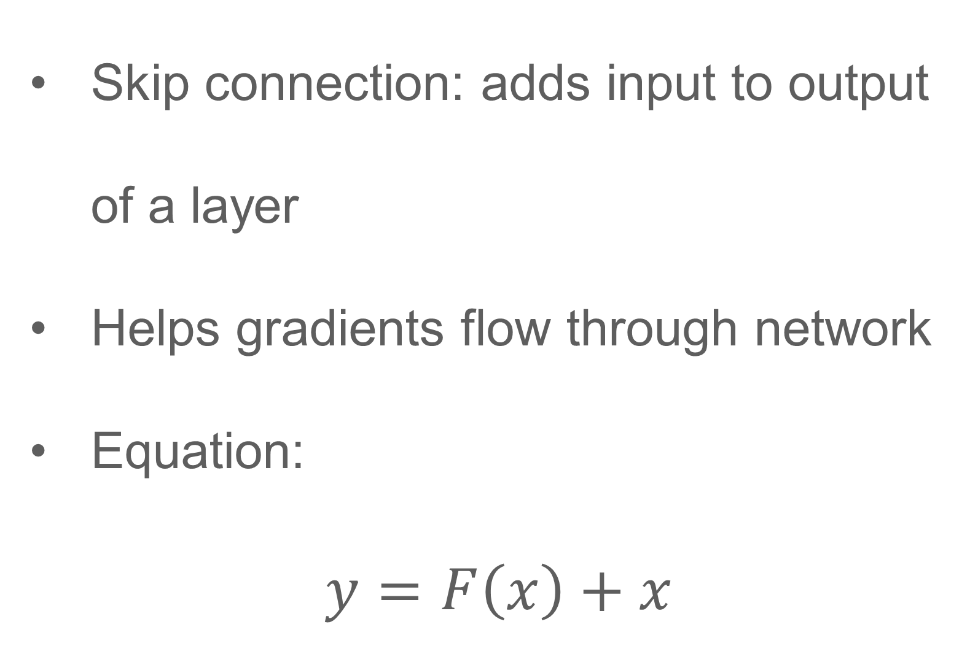
What is a Residual Block?
Skip connection: adds input to output of a layer
Helps gradients flow through network
Equation:
$$y=F\left(x\right)+x$$

Slide 12
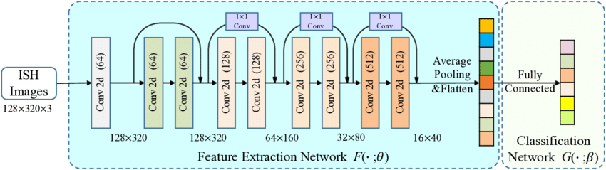
ResNet Architecture
Deep CNN with residual blocks
Variants: ResNet-18, 34, 50, 101
State-of-the-art performance
Very stable for transfer learning

Slide 13
TRANSFER LEARNING

Slide 14
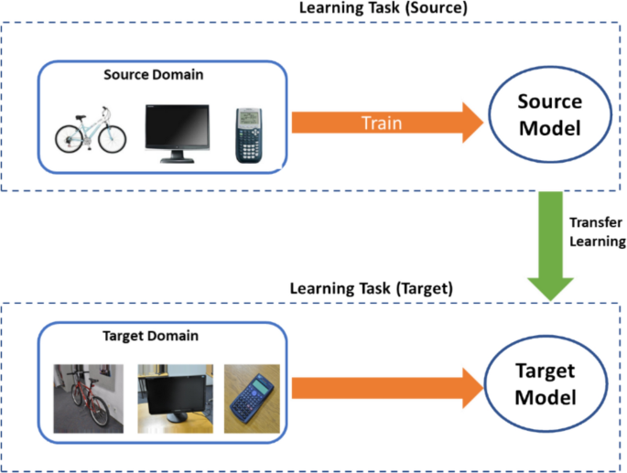
What is Transfer Learning?
Use a model pretrained on a large dataset (e.g., ImageNet)
Transfer learned features to new, smaller dataset
Fine-tune or freeze some layers

Slide 15
When to Use Transfer Learning?
When you have limited data
When the problem is similar to ImageNet (images)
When training a large model from scratch is too expensive

Slide 16
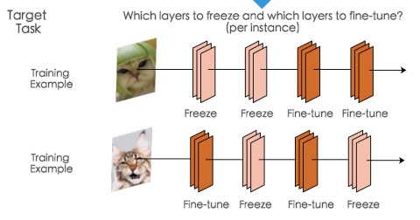
Two Approaches
Feature Extraction:
  Freeze all pretrained layers
  Replace classifier head
Fine-Tuning:
  Start from pretrained weights
  Unfreeze deeper layers gradually
  Lower learning rate

Slide 17
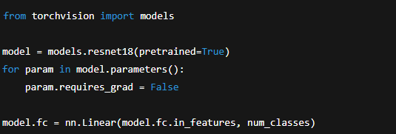
Example: Transfer Learning in PyTorch

Slide 18

Code: Fine-Tuning Last Layers

Slide 19
DATA AUGMENTATION

Slide 20
What is Data Augmentation?
Applies transformations to training images
Simulates additional training data
Improves generalization, especially with small datasets

Slide 21
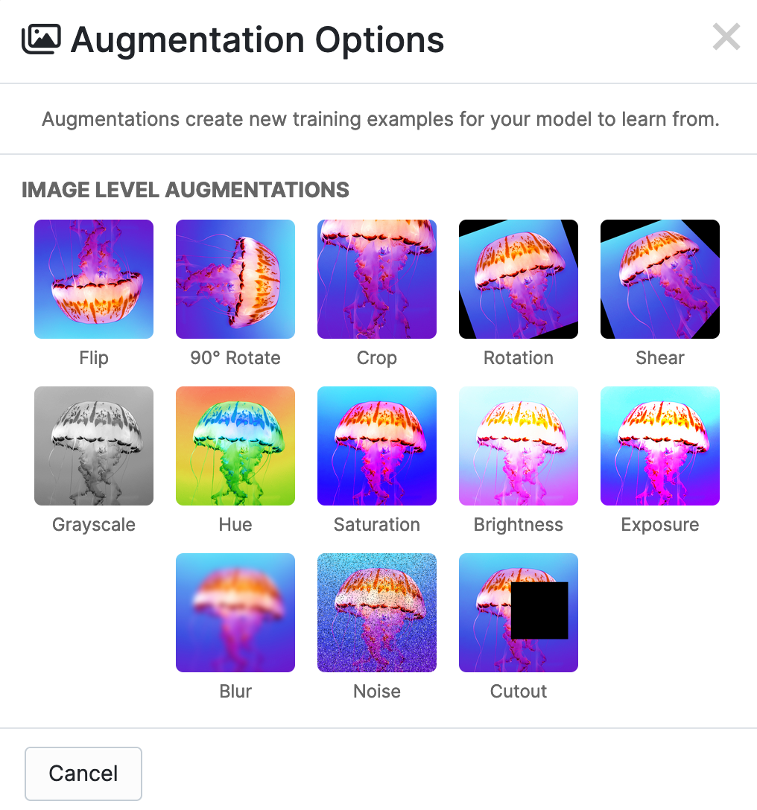
Common Augmentation Techniques
Flip (horizontal, vertical)
Rotation (±10–30°)
Crop & Zoom
Color jitter (brightness, contrast)
CutMix, MixUp (advanced)

Slide 22
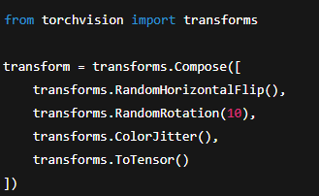
Code: Augmentation in PyTorch

Slide 23
MODERN ARCHITECTURES

Slide 24
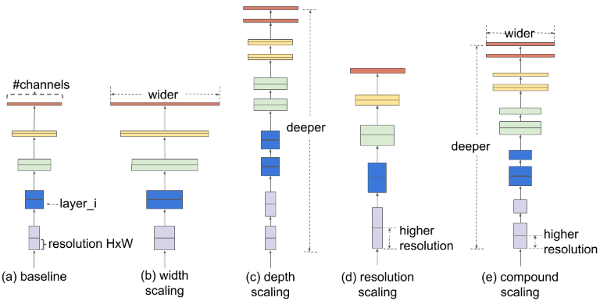
EfficientNet Overview
Uses compound scaling (depth, width, resolution)
Efficient and powerful
Variants: B0 (small) → B7 (large)
Good default for real-world applications

Slide 25
Pretrained Model Sources
torchvision.models (ResNet, VGG, MobileNet)
timm (many state-of-the-art models)
HuggingFace Transformers (for vision transformers)
HuggingFace Spaces for visual demos

Slide 26
PRACTICAL CONSIDERATIONS

Slide 27
Transfer Learning Workflow
Choose pretrained model
Decide layers to freeze/unfreeze
Replace classifier
Apply augmentation
Train and evaluate
Tune hyperparameters

Slide 28
Challenges
Mismatched input sizes → need resizing
Overfitting if pretrained model is too big
Catastrophic forgetting if fine-tuned too fast

Slide 29
Best Practices
Always start with feature extraction
Use lr_scheduler for fine-tuning phases
Try EarlyStopping or validation checkpoints
Visualize feature maps before/after fine-tuning

Slide 30
Summary
BatchNorm and Residual Connections enable deep training
Transfer learning accelerates training with limited data
Pretrained models save time and boost accuracy
Augmentation is essential for generalization

Slide 31
References

Slide 32
References
Amita Kapoor; Antonio Gulli; Sujit Pal; François Chollet, Deep Learning with TensorFlow and Keras: Build and deploy supervised, unsupervised, deep, and reinforcement learning models , Packt Publishing, 2022.
Géron, Hands-On ML, Ch. 14: CNNs
Stanford CS231n: CNNs Visual Intuition
Goodfellow et al., Deep Learning, Ch. 9

